Slide 1
LENSES
An On-Demand Approach to ETL
Sanyam Sachdeva :A20355329
Prasanth Bhagavatula :A20355611
Sandeep Baradi :A20352613

Slide 2
Lenses
Three mentalities in data analytics.
Reliable analytics is impossible without high quality data.
Ad-hoc approach by pooling data into data lake.
On-demand approach which allows incremental curation of data.

Slide 3
Probabilistic Database
It is an uncertain database in which possible worlds are associated with probability.
Probabilistic Query Processing System runs a deterministic query by listing all probable answers with marginal probability.
a1 | b1, b3
a2 | b2, b4
a1 | b1
a2 | b2
a1 | b3
a2 | b2
a1 | b1
a2 | b4
a1 | b3
a2 | b4

Slide 4
C-Tables & PC-Tables
A C-Table is a relation instance where each tuple is annotated with a lineage formula φ over alphabet of variables ∑.
A PC-Table is a C-Table augmented with probability measure over the possible assignments to variables in ∑.
a1 | b1 | x1 = 1
a2 | b2 | x1 = 2
a1 | b1
a2 | b2

Slide 5
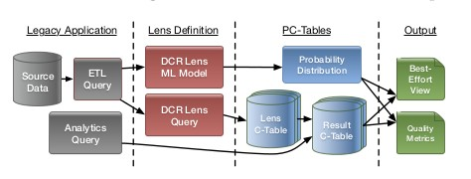
Lens Framework

Slide 6
Domain Constraint Repair Lens
A Domain Constraint repair lens enforces attribute-level constraints such as NOT NULL. With sch(Q) = {a₁, t₁, . . . , a_{n}, t_{n}} denoting the attributes a_{i} of Q(D) and their type t_{i}, a domain constraint repair lens definition has the form:
… USING DOMAIN_REPAIR(a₁ t₁,..., a_{n} t_{n})
The C-Table for the lens output is constructed by the query F_{lens} = π{...,a_{i} ←V_{i},...}, where each V_{i} is defined as:
if t_{i} ╞ a_{i} then a_{i} else Var(Name_{i} , ROWID))

Slide 7
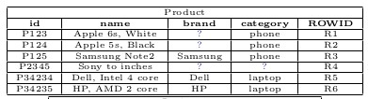
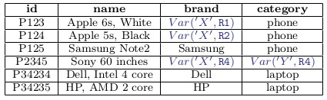
DCR Lens Example
CREATE LENS SaneProduct AS SELECT * FROM Product USING DOMAIN_REPAIR(category string NOT NULL, brand string NOT NULL);

Slide 8
Schema Matching Lens
A schema matching lens creates a mapping from the source data’s schema to a user-defined target schema. Given a destination schema {b₁, t₁, . . . , b_{m}, t_{m}} and a threshold ω, a schema matching lens definition has the form:
... USING SCHEMA_MATCHING(b₁ t₁,..., b_{m} t_{m}, ω)
The schema matching lens defines a fresh boolean variable Var(Name_{i,j}) for every pair a_{i}, b_{j}, where a_{i}, t_{j} ∈ sch(Q). So, F_{lens} = π{..., b_{j} ←V_{j},...}, where V_{j} enumerates possible matches for b_{j}:
if Var(Name_{1,j}) then a₁ else
.
.
if Var(Name_{n,j}) then a_{n} else NULL

Slide 9
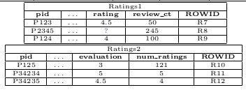
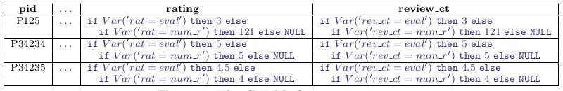
Schema Matching Lens Example
CREATE LENS MatchedRatings2 AS SELECT * FROM Ratings2 USING SCHEMA_MATCHING( pid string, ..., rating float, review_ct float, NO LIMIT);
CREATE VIEW AllRatings AS SELECT * FROM MatchedRatings2 UNION SELECT * FROM Ratings1;

Slide 10
Composing Lenses
CREATE LENS SaneRatings AS SELECT pid, category, rating, review_ct FROM AllRatings USING DOMAIN_REPAIR(rating DECIMAL NOT NULL)
Three possibilities for lenses:
No new variables are introduced
Variables introduced are independent of P_{in}.
Variables introduced are dependent on P_{in}.
However, it’s not always possible to express dependencies explicitly.
Three mechanisms to enable support for lenses.
Train lenses on most likely output.
Train lenses on samples of rows drawn.
Train lenses on subset of data that is fully deterministic.

Slide 11
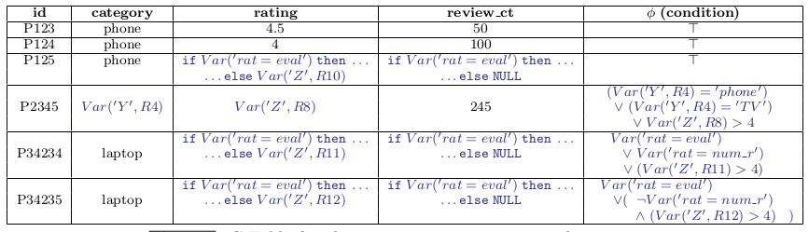
Composing Lenses cont.
SELECT p.pid, p.category, r.rating, r.review_ctFROM SaneRatings r NATURAL JOIN Product p WHERE p.category IN (‘phone’,‘TV’) OR r.rating > 4

Slide 12
Virtual C-Tables
Used to deploy PQP techniques necessary to support Lenses into existing ETL pipeline.
Decouple the deterministic components of a query from the non-deterministic components that define a PC-Table.
The probability measure P of a PC-Table (F(D), P) is not affected by running deterministic queries Q.
This enables us to rewrite the queries as:
Q((F(D), P))≡ F'(Q'(D))
where Q' is deterministic and F' is non-deterministic.

Slide 13
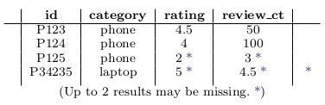
The Result
Obtaining Two Relational Tables
Deterministic relation R_{det}: Containing certain (definite) answers, query on virtual C tables and all the Non deterministic values are replaced with NULL.
SELECT e ​(*->NULL) AS a ​FROM Q(D) WHERE Φ (* -> NULL)
Best-guess relation R_{guess}: Evaluate Q(D) for deterministic results, and then evaluative each uncertain tuple with conditions for best guess using maximum probability i.e the value in the most likely possible worlds.

Slide 14
Result Quality
How reliable are the best-guess results?
Best guess: Nondeterministic value(R_{guess}) already have various metrics to gauge attributes values derives from Probabilistic databases.
Possible tuples:Define noise- the unnecessary tuples added which hide possibly useful information tuple level uncertainty – whether the tuple exist in real world
P measure from P-table gives binomial distribution function, skewed
On other hand if not skewed we use Shannon Entropy :
Entropy(t)= - ( p_{t} . log₂(p_{t})) + (1 - p_{t}) . log₂(1 - p_{t}))

Slide 15
Feedback
What if the results are not good enough?
Analyst puts in effort to gather evidence-’ground truth’
Ex: Are rating an evaluation mean the same thing in different schema?
Earlier represented using var(‘rat=eval’) in c-table
Idea is to replace variables to reduce noise.
Typically there are budget constraints linked to finding ground truth
Quality Vs cost :
In real world Analyst finds a balance.
Define unknown hidden value function V() to maximize depending on C() cost & N() noise, how much to pay for given improvement in result
This trade-off called Cost of perfect information. (CPI)- could use greedy strategy.

Slide 16
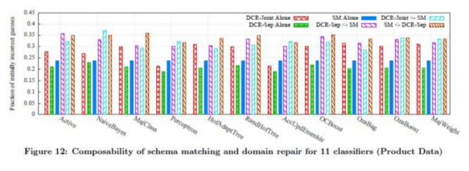
Experiments
Schema matching
For schema matching we use distance metrics such as Levenstein, JaroWinkler, and N-Gram to determine attributes similarity based on threshold. We take the average of all and normalize them to get the final similarity score.
Domain Constraint Repair
For domain constraint repair (finding missing values or null values) we use different machine learning algorithm to estimate probability distribution of all candidate repairs(DCR-Joint, DCR-sep & SM).

Slide 17
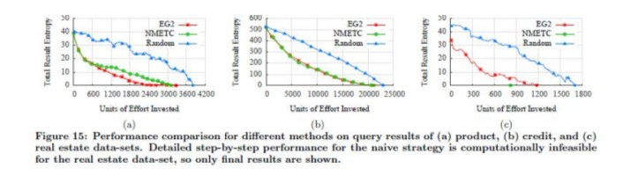
Experiments cont.
For prioritizing curation tasks we use algorithms such as:
NMETC: selects variables that minimizes the global expected total cost.
Greddy : makes locally optimal choice.
Random: tasks selected in random order (provides base –line).

Slide 18
Conclusion
An On-Demand ETL with task-specific on demand curation solutions.
Composable operators called lenses capable to work with non-deterministic data.
Use PC-tables with deterministic values.
Provides best-effort guesses for non-deterministic values, and evaluation of quality of these values.
Heuristics for prioritizing curation tasks.

